Slide 1
Problems and Search

Slide 2
To build a system to solve a problem
Define the problem precisely
Analyse the problem
Isolate and represent the task knowledge that is necessary to solve the problem
Choose the best problem-solving techniques and apply it to the particular problem.

Slide 3
Defining the problem as State Space Search
The state space representation forms the basis of most of the AI methods.
Its structure corresponds to the structure of problem solving in two important ways:
It allows for a formal definition of a problem as the need to convert some given situation into some desired situation using a set of permissible operations.
It permits us to define the process of solving a particular problem as a combination of known techniques (each represented as a rule defining a single step in the space) and search, the general technique of exploring the space to try to find some path from current state to a goal state.

Slide 4
Problem Solving Agents
Intelligent Agents
Goal
Objectives
Actions
Problem Solving
Goal Formulation
Problem Formulation
Search, Solution, Execute
Formulate, Search, Execute

Slide 5
Problem Solving Agents
Problem Solving
Goal Formulation: It is the first and simplest step in problem-solving. It organizes the steps/sequence required to formulate one goal out of multiple goals as well as actions to achieve that goal. Goal formulation is based on the current situation and the agent’s performance measure
Problem Formulation: It is the most important step of problem-solving which decides what actions should be taken to achieve the formulated goal.

Slide 6
Problem Solving Agents
Problem Solution
Fixed sequence of Actions
Search
Process of looking for a sequence of actions to achieve the GOAL
Execution
Recommended Actions to achieve the goal

Slide 7
Problem Solving Agents
Aim
To find the sequence of actions and states that lead from the start state to the goal state

Slide 8
Problem Solving Agents
Components of Problem Statement
Initial State
Start State
Action
Possible Actions
Transition Model
Result of each action
Goal Test
Whether resultant state is goal state
Path Cost
Sum of costs of individual actions along the path

Slide 9
Problem Solving Agents
State Space
All states reachable from initial state by any sequence of actions
Forms a directed network / Graph
Nodes: States ; Links : Actions
Path
Sequence of States connected by sequence of actions

Slide 10
Toy Problems
Vacuum World
State Space
Agent location and dirt locations
8 possible states
Initial State
Actions
Transition Model
Goal Test
Path Cost

Slide 11
Toy Problems
Vacuum World

Slide 12
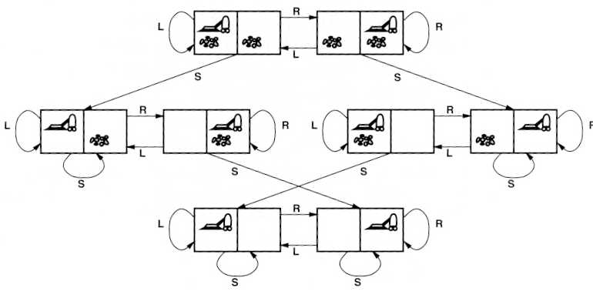
Assume, the agent knows where located and the dirt places
Goal test: no dirt left in any square
Path cost: each action costs one
States: one of the eight states
Operators:
move left L
move right R
suck S
Initial state: any
Goal states

Slide 13
Single-state problem
Actions: Left, Right, Suck
Goal state: 7, 8
Initial state: 5
Solution: [Right, Suck]
1
2
5
6
3
4
7
8

Slide 14
Multiple-state problem
Actions: Left, Right, Suck
Goal state: 7, 8
Initial state: one of {1,2,3,4,5,6,7,8}
Right: one of 2,4,6,8
Left: one of 1,3,5,7
Solution: [Right, Suck, Left, Suck]
1
2
5
6
3
4
7
8

Slide 15
Toy Problems
8-Puzzle
State Space
Positioning of the 8 tiles and blank tile on 3X3 board
Initial State
Actions
Transition Model
Goal Test
Path Cost

Slide 16
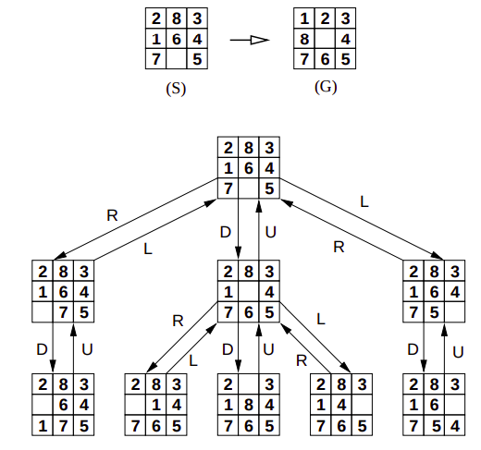
Toy Problems
8-Puzzle - Problem: Go from state S to state G.

Slide 17
States: configurations of tiles
Operators: move one tile Up/Down/Left/Right
Note:
There are 9! = 362, 880 possible states

Slide 18
Toy Problems
8-Queens Problem
State Space
All possible combinations on a 8X8 board
Initial State
Actions
Transition Model
Goal Test
Path Cost

Slide 19
Toy Problems
8-Queens Problem

Slide 20
Real World Problems
Applications
Route Finding Problem
- Travelling Salesman Problem
VLSI design layout
Positioning of wind blades
Protein Sequence design

Slide 21
Real World Problems
Route Finding Problem: Airline Travel Plan
State Space
Initial State
Actions
Transition Model
Goal Test
Path Cost

Slide 22
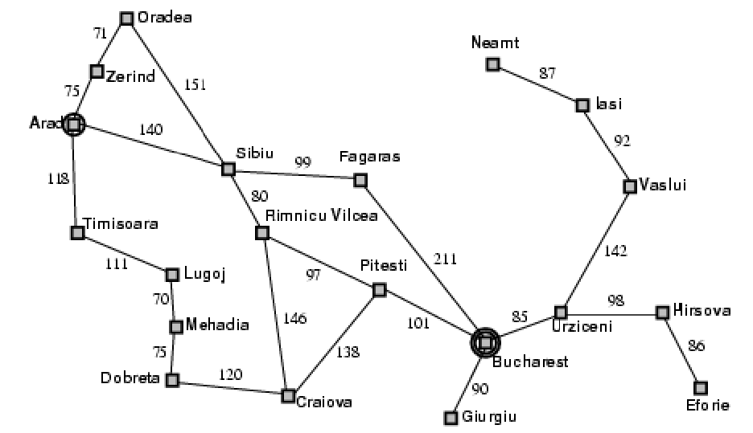
Problem Solving Agents
Example
On a tour to Romania, currently in Arad, flight leaves from Bucharest the next day

Slide 23
Problem Solving Agents
Example
Goal Formulation
To reach Bucharest
Problem Formulation
States : In between cities
Actions : Drive through adjacent cities
Find Solution
Drive through sequence of cities
Arad, Sibiu, Fagaras, Bucharest

Slide 24
SEARCH FOR SOLUTIONS

Slide 25
SEARCH
Tree Search
Initial State : Root
Actions : Branches
State Space : Nodes
Finding route from Arad to Bucharest
Initial State : In(Arad)
Actions : Go(Sibiu), Go(Timisoara), Go(Zerind)
Result(In(Arad), Go(Sibiu))= In(Sibiu)
State Space
{Arad, Sibiu}, {Arad, Sibiu, Fagaras}, {Arad, Sibiu, Fagaras, Bucharest}

Slide 26
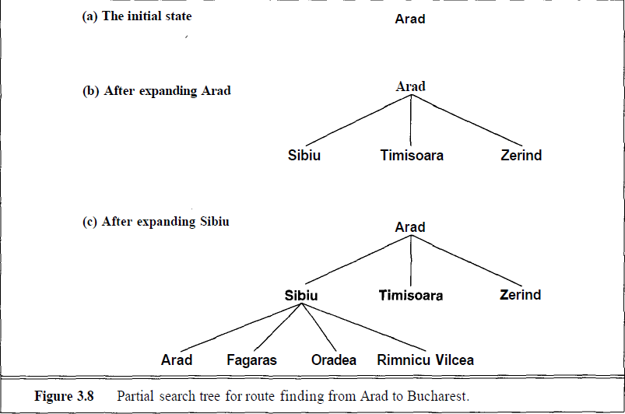
TREE SEARCH

Slide 27
SEARCH STRATEGY
Performance Measurement of Search Strategies
Completeness
Does it always find a solution if it exists
Optimality
Is the solution optimal? (Least Cost path)
Time Complexity
Time taken to find optimal solution/ nodes generated
Space Complexity
Memory requirement for nodes

Slide 28
Search Strategies
1. Uninformed search (blind search)
Having no information about the number of steps from the current state to the goal.
2. Informed search (heuristic search)
More efficient than uninformed search.

Slide 29
UNINFORMED SEARCH STRATEGIES

Slide 30
UNINFORMED / BLIND SEARCH
Blind Search Characteristics
No domain specific knowledge
Use only the information available in problem statement
Can only generate successors and distinguish between a goal state from a non-goal state
No preference as to which state (node) will be more promising, expansion done systematically according to a specific order
Uses brute force approach
Goal Check
Generation
Expansion

Slide 31
Search Implementation
Two types of data structure are needed for systematic search:
Fringe are set of nodes that
have been discovered
but not yet been “processed”:
tested for goal state
discovered their children
Also known as open nodes
Visited nodes are set of nodes that
have been discovered
have been processed:
tested whether they are a goal
have discovered all their children
Also known as closed nodes

Slide 32
UNINFORMED / BLIND SEARCH
Blind Search Strategies
Breadth First Search
Uniform Cost Search
Depth First Search
Depth Limited Search
Iterative Deepening DFS
Bidirectional Search
Characterized by the order in which they expand the nodes
Impacts the performance

Slide 33
Breadth First Search - Method
Expand Root Node First
Expand all nodes at level 1 before expanding level 2.Expand all neighbours of a node (breadth) before any of its successors is expanded (depth)
OR
Expand all nodes at level d before expanding nodes at level d+1.
Frontier(Fringe) is a FIFO queue (first-in-first-out, new nodes go to end of queue)

Slide 34
Breadth First Search
Algorithm:
Create a variable called NODE-LIST and set it to initial state
Until a goal state is found or NODE-LIST is empty do
Remove the first element from NODE-LIST and call it E. If NODE-LIST was empty, quit
For each way that each rule can match the state described in E do:
Apply the rule to generate a new state
If the new state is a goal state, quit and return this state
Otherwise, add the new state to the end of NODE-LIST

Slide 35
Breadth-first Search
A
Successors: B,C,D
D
B
C
Initial state
E
F
G
H
I
J
K
L
M
N
O
P
Q
R
S
T
Goal state
U
Visited:
Fringe(Frontier): A (FIFO)

Slide 36
Breadth-first Search
A
Next node
D
Successors: E,F
B
C
E
F
G
H
I
J
K
L
M
N
O
P
Q
R
S
T
U
Visited: A
Fringe: B,C,D (FIFO)

Slide 37
Breadth-first Search
A
Next node
Successors: G,H
D
B
C
E
F
G
H
I
J
K
L
M
N
O
P
Q
R
S
T
U
Visited: A, B
Fringe: C,D,E,F (FIFO)

Slide 38
Breadth-first search
A
Next node
Successors: I,J
B
C
D
E
F
G
H
I
J
K
N
O
P
Q
R
L
M
S
T
U
Visited: A, B, C
Fringe: D,E,F,G,H (FIFO)

Slide 39
Breadth-first Search
A
Successors: K,L
D
B
C
Next node
E
F
G
H
I
J
K
L
M
N
O
P
Q
R
Visited: A, B, C, D
S
T
U
Fringe: E,F,G,H,I,J (FIFO)

Slide 40
Breadth-first Search
A
Successors: M
D
B
C
Next node
E
F
G
H
I
J
K
L
M
N
O
P
Q
R
Visited: A, B, C, D, E
S
T
U
Fringe: F,G,H,I,J,K,L (FIFO)

Slide 41
Breadth-first Search
A
Successors: N
D
B
C
Next node
E
F
G
H
I
J
K
N
O
P
Q
R
L
M
Visited: A, B, C, D, E, F
S
T
U
Fringe: G,H,I,J,K,L,M (FIFO)

Slide 42
Breadth-first Search
A
Successors: O
D
B
C
Next node
E
F
G
H
I
J
K
L
M
N
O
P
Q
R
U
Visited: A, B, C, D, E, F, G
S
T
Fringe: H,I,J,K,L,M,N (FIFO)

Slide 43
Breadth-first Search
A
Successors: P,Q
D
B
C
Next node
E
F
G
H
I
J
K
L
M
N
O
P
Q
R
Visited: A, B, C, D, E, F, G, H
S
T
U
Fringe: I,J,K,L,M,N,O (FIFO)

Slide 44
Breadth-first Search
A
Successors: R
D
B
C
Next node
E
F
G
H
I
J
K
L
M
N
O
P
Q
R
Visited: A, B, C, D, E, F, G, H, I
S
T
U
Fringe: J,K,L,M,N,O,P,Q (FIFO)

Slide 45
Breadth-first Search
A
Successors: S
D
B
C
E
F
G
H
I
J
Next node
K
L
M
N
O
P
Q
R
Visited: A, B, C, D, E, F, G, H, I, J
S
T
U
Fringe: K,L,M,N,O,P,Q,R (FIFO)

Slide 46
Breadth-first Search
A
Successors: T
D
B
C
E
F
G
H
I
J
Next node
K
L
M
N
O
P
Q
R
Visited: A, B, C, D, E, F, G, H, I, J, K
S
T
U
Fringe: L,M,N,O,P,Q,R,S (FIFO)

Slide 47
Breadth-first Search
A
Successors:
D
B
C
E
F
G
H
I
J
K
L
M
N
O
P
Q
R
Next node
Visited: A, B, C, D, E, F, G, H, I, J, K, L
S
T
U
Fringe: M,N,O,P,Q,R,S,T (FIFO)

Slide 48
Breadth-first Search
A
Goal state achieved
Successors:
D
B
C
E
F
G
H
I
J
K
L
M
N
O
P
Q
R
Next node
Visited: A, B, C, D, E, F, G, H, I, J, K, L, M
S
T
U
Fringe: N,O,P,Q,R,S,T (FIFO)

Slide 49
BREADTH FIRST SEARCH

Slide 50
Evaluating Breadth First Search
Observations
Very systematic
If there is a solution breadth first search is guaranteed to find it
If there are several solutions then breadth first search will always find the shallowest goal state first and if the cost of a solution is a non-decreasing function of the depth then it will always find the cheapest solution

Slide 51
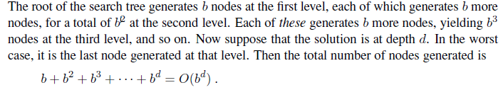
Evaluating Breadth First Search
Completeness Yes, if b is finite
Time Complexity
Space Complexity
Every node must remain in memory - O(b^{d})
If it is either a frontier node or an ancestor of a frontier node
Goal will be in the frontier and its ancestors will be needed for the solution path
Optimality Yes, for uniform costs (e.g., if cost = 1 per step)

Slide 52
Note : The space/time complexity could be less as the solution could be found anywhere on the d^{th} level.
Space is more of a factor to breadth first search than time
Time is still an issue

Slide 53
Depth First Search - Method
Expand Root Node First
Explore one branch of the tree before exploring another branch. Expand all successors of a node first (depth) before any of its neighbours is expanded (breadth).
If a leaf node do not represent a goal state, search backtracks up to the next highest node that has an unexplored path
Frontier is a LIFO queue (Last-in-first-out, new nodes at the beginning of the queue)

Slide 54
Algorithm: Depth First Search
If the initial state is a goal state, quit and return success
Otherwise, do the following until success or failure is signaled:
Generate a successor, E, of initial state. If there are no more successors, signal failure.
Call Depth-First Search, with E as the initial state
If success is returned, signal success. Otherwise continue in this loop.

Slide 55
Depth-First Search
A
Successors: B,C,D
D
B
C
Initial state
E
F
G
H
I
J
K
L
M
N
O
P
Q
R
S
T
U
Goal state
Visited:
Fringe: A (LIFO)

Slide 56
Depth-First Search
A
Successors: E,F
D
B
C
E
F
G
H
I
J
K
L
M
N
O
P
Q
R
S
T
U
Visited: A
Fringe: B,C,D (LIFO)

Slide 57
Depth-First Search
A
Successors: K,L
D
B
C
E
F
G
H
I
J
K
L
M
N
O
P
Q
R
Visited: A, B
S
T
U
Fringe: E,F,C,D (LIFO)

Slide 58
Depth-First Search
A
Successors: S
D
B
C
E
F
G
H
I
J
K
L
M
N
O
P
Q
R
S
T
U
Visited: A, B, E
Fringe: K,L,F,C,D (LIFO)

Slide 59
Depth-First Search
A
Successors:
D
B
C
E
F
G
H
I
J
K
L
M
N
O
P
Q
R
S
T
U
Visited: A, B, E, K
Fringe: S,L,F,C,D (LIFO)

Slide 60
Depth-First Search
A
Successors: T
D
B
C
E
F
G
H
I
J
K
L
M
N
O
P
Q
R
Visited: A, B, E, K, S
S
T
U
Backtracking
Fringe: L,F,C,D (LIFO)

Slide 61
Depth-First Search
A
Successors:
D
B
C
E
F
G
H
I
J
K
L
M
N
O
P
Q
R
Visited: A, B, E, K, S, L
S
T
U
Fringe: T,F,C,D (LIFO)

Slide 62
Depth-First Search
A
Successors: M
D
B
C
E
F
G
H
I
J
K
L
M
N
O
P
Q
R
Visited: A, B, E, K, S, L, T
S
T
U
Backtracking
Fringe: F,C,D (LIFO)

Slide 63
Depth-First Search
A
D
Successors:
B
C
E
F
G
H
I
J
K
L
M
N
O
P
Q
R
Visited: A, B, E, K, S, L, T, F
S
T
U
Fringe: M,C,D (LIFO)

Slide 64
Depth-First Search
A
Successors: G,H
D
B
C
E
F
G
H
I
J
K
L
M
N
O
P
Q
R
Visited: A, B, E, K, S, L, T, F, M
S
T
U
Backtracking
Fringe: C,D (LIFO)

Slide 65
Depth-First Search
A
Successors: N
D
B
C
E
F
G
H
I
J
K
L
M
N
O
P
Q
R
Visited: A, B, E, K, S, L, T, F, M, C
S
T
U
Fringe: G,H,D (LIFO)

Slide 66
Depth-First Search
A
Goal state achieved
Successors:
D
B
C
Finished search
E
F
G
H
I
J
K
L
M
N
O
P
Q
R
Visited: A, B, E, K, S, L, T, F, M, C, G
S
T
U
U
Fringe: N,H,D (LIFO)

Slide 67
Depth-First Search Observations
Only needs to store the path from the root to the leaf node as well as the unexpanded nodes.
Completeness
Yes, in finite spaces if repetitions are avoided
No, fails infinite depth space and in loops
Time Complexity
Depth First Search has a time complexity of O(b^m), where b is the maximum branching factor of the search tree and m is the maximum depth of the state space.
Space Complexity
Only nodes in current path and their siblings need to store, O(bm)
Optimality
No, Longer paths may be found before shorter ones.
Yes, if it is finite

Slide 68
Uniform Cost Search
BFS will find the optimal (shallowest) solution so long as all step costs are equal.
Uniform Cost Search can be used when this is not the case and uniform cost search will find the cheapest solution provided that the cost of the path never decreases as we proceed along the path.
Instead of expanding the shallowest node, Uniform Cost Search works by expanding the node n with the lowest path cost on the fringe.

Slide 69
Uniform Cost Search
A
10
1
S
5
B
5
D
5
15
C
Similar to BFS except that it sorts (ascending order)
the nodes in the fringe according to the cost of the node.
where cost is the path cost, g(n).

Slide 70
Uniform Cost Search
Fringe = [S₀]
A
10
1
S
5
B
5
D
5
15
C
Next Node=Head of Fringe=S, S is not goal
Successor(S)={C,B,A}=expand(S) but sort them according to path cost.
Updated Fringe=[A₁,B₅,C₁₅]

Slide 71
Uniform Cost Search
Fringe = [A₁,B₅,C₁₅]
A
10
1
S
5
B
5
D
5
15
C
Next Node=Head of Fringe=A, A is not goal
Successor(A)={D}=expand(A)
Sort the queue according to path cost.
Updated Fringe=[B₅,D₁₁,C₁₅]

Slide 72
Uniform Cost Search
Fringe = [B₅,D₁₁,C₁₅]
A
10
1
S
5
B
5
D
5
15
C
Next Node=Head of Fringe=B, B is not goal
Successor(B)={D}=expand(B)
Sort the queue according to path cost.
Updated Fringe=[D₁₀,D₁₁,C₁₅]

Slide 73
Uniform Cost Search
Fringe = [D₁₀,D₁₁,C₁₅]
A
10
1
S
5
B
5
D
5
15
C
Next Node=Head of Fringe=D,
D is a GOAL (cost 10 = 5+5)
S→B→D
Always finds the
cheapest solution

Slide 74
UNIFORM COST SEARCH

Slide 75
UNIFORM COST SEARCH

Slide 76
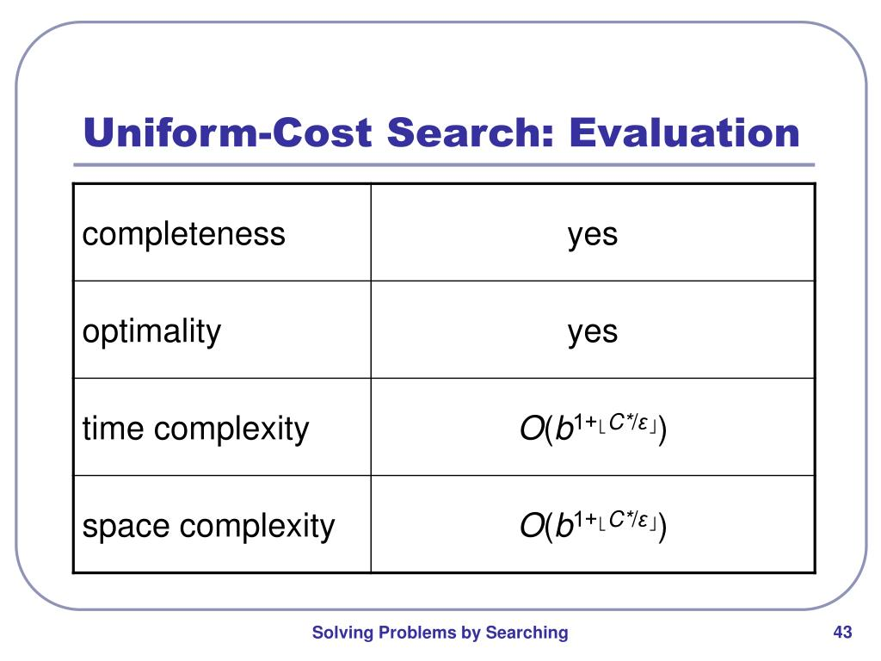
Uniform Cost Search
where b is the branching factor, c is the cost of optimal cost, and ε is the cost between any two states.

Slide 77
INFORMED SEARCH STRATEGIES

Slide 78
INFORMED SEARCH
Informed Search Characteristics
Has domain specific knowledge
Knowledge associated with a node is its value
Values can be
Path Cost
Distance to reach the goal
How to reach the goal
Useful for larger search space
Uses Heuristic; hence called Heuristic Search

Slide 79
BEST FIRST SEARCH
Search procedures differ in the way they determine the next node to expand
Uninformed Search: Rigid procedure with no knowledge of the cost of a given node to the goal
Informed Search:
Evaluation function f(n) - Knowledge of the worth of expanding a node n( lowest cost estimate)
Heuristic Function - f(n) includes as a component in a heuristic function h(n), which estimates the costs of the cheapest path from n to the goal
Best-First Search: Informed search procedure that expands the node with the “best” f-value first

Slide 80
HEURISTIC SEARCH
Heuristic
Evaluation function in Greedy Search
Derived from Greek
Introduced by Mathematician Polya in problem solving techniques
Heuristics in AI
Fast but incomplete in certain situations
Improves the search
Heuristics is problem specific and focuses on the Search

Slide 81
GREEDY BEST FIRST SEARCH
Greedy Best First Search
Expand the node closest to the goal
h(n) = estimated path cost from n to the goal node
Greedy Search
Best-First Search using h(n) as evaluation function
f(n)=h(n)
Ignores g(n), the cost to get to n
Uses h(n)
Example: Find a route from Arad to Bucharest
hSLD - Uses Straight line distance as heuristic

Slide 82
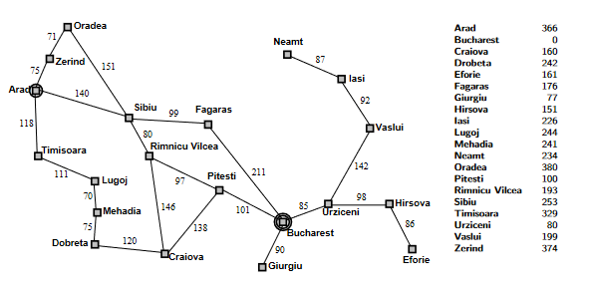
GREEDY BEST FIRST SEARCH
Route Map of Romania SLD to Bucharest

Slide 83
GREEDY BEST FIRST SEARCH
Initial State:Arad
Goal State: Bucharest
Visited : nil
Frontier Queue
Arad 366

Slide 84
As per heuristic function, h(n) = estimated cost of the cheapest path from node n to a goal state.
Start from Arad, the branches of Arad are sibiu, Zerind and Timsoara.
The distance from sibiu, Timsoara and Zerind to bucharest are 253,329 and 374. so the minimum is sibiu.

Slide 85
GREEDY BEST FIRST SEARCH
Visited: Arad
Frontier Queue
Sibiu 253
Timisoara 329
Zerind 374
Expand siblu. The branches of sibiu are Arad, Fagaras, Oradea, Rinea Vicca. As Arad is considered earlier, neglect Arad.
Distance from Fagaras, Oradea, Rinea Vicca to bucharest is 176,380 and 193. The minimum is Faganus.

Slide 86
GREEDY BEST FIRST SEARCH
Visited: Arad, sibiu
Frontier Queue
Fagaras 176
R. Vilcea 193
Timisoara 329
Arad 366
Zerind 374
Oradea 380
Expand Fagaras next. The Bucharest is reached.

Slide 87
GREEDY BEST FIRST SEARCH
Visited: Arad, Sibiu,Fagaras
Frontier Queue
Bucharest 0
R. Vilcea 193
Sibiu 253
Timisoara 329
Arad 366
Zerind 374
Oradea 380
Route: Arad->Sibiu->Fagaras->Bucharest

Slide 88
GREEDY BEST FIRST SEARCH
Completeness
No: Infinite Loops
Eg: Iasi->Neamt->Iasi->Neamt->..

Slide 89
GREEDY BEST FIRST SEARCH
Optimality
No
Route: Arad->Sibiu->Fagaras->Bucharest (450 Km)
Shortest:Arad->Sibiu->R.Vilcea->Pitesti->Bucharest (418 Km)

Slide 90
Pseudo code
1.Create 2 empty lists: Frontier and Visited
2.Start from the initial node (say N) and put it in the ‘ordered’ Frontier list
3.Repeat the next steps until the GOAL node is reached .
1.If the Frontier list is empty, then EXIT the loop returning ‘False’
2. Select the first/top node (say N) in the Frontier list and move it to the Visited list. Also, capture the information of the parent node
3. If N is a GOAL node, then move the node to the Visited list and exit the loop returning ‘True’. The solution can be found by backtracking the path
4. If N is not the GOAL node, expand node N to generate the ‘immediate’ next nodes linked to node N and add all those to the Frontier list
5. Reorder the nodes in the Frontier list in ascending order
according to an evaluation function f(n).

Slide 91
GREEDY BEST FIRST SEARCH
Reduces search time drastically
Search cost is minimal
But not complete / optimal
What’s the alternate?

Slide 92
A* SEARCH
A* Search
Minimization of estimated path costs
Idea
Avoid expanding paths that are expensive rather expand most promising first
Greedy Search + Uniform search
Method
f(n)=h(n)+g(n)
f(n): Estimated total cost of path through n to goal
g(n): actual cost from initial state to n (Initial to n)
h(n): estimated cost of path from n to the goal (n to goal)

Slide 93

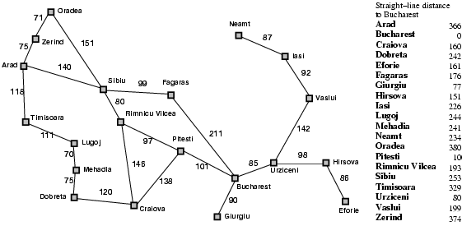
A* search example

Slide 94
Cont..
Evaluation function f(n) = g(n) + h(n)
g(n) = cost so far to reach n
h(n) = estimated cost from n to goal
In the example identify the path from Arad to Bucharest. As per heuristic function, find f(n).
Start from Arad, the branches of Arad are sibiu, Zerind and Timsoara. The f(n) is calculated as,
Sibiu= 393=140+253=arad to sibiu+ sibiu to bucharest.
Zerind =447=118+329= arad to zerind + zerind to bucharest
Timsoara = 449=75+374=arad to timsoara + timsoara to bucharest .So the minimum is sibiu. Expand sibiu and continue...

Slide 95
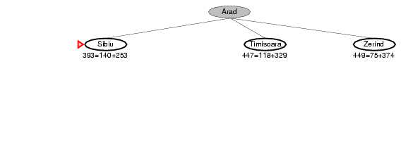
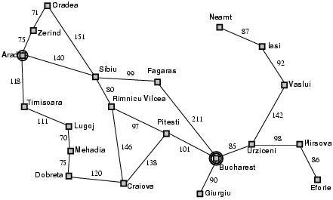
A* search example

Slide 96
cont..
When the f(n) value is calculated for any node n ,
f(n)=cost from initial node to node n g(n)+ node n to goal node h(n).
In the following diagram, f(n) value for Fagaras is
g(n)= cost from Arad to sibiu + sibiu to fagaras=140+99=253
h(n)=cost from fagaras to bucharest= 176.
So, f(n) for fagaras=253+176=415.
Similarly find f(n) for other nodes, then find the minimum cost and expand the node.

Slide 97
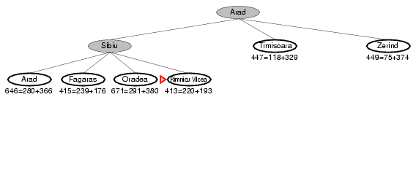
A* search example

Slide 98
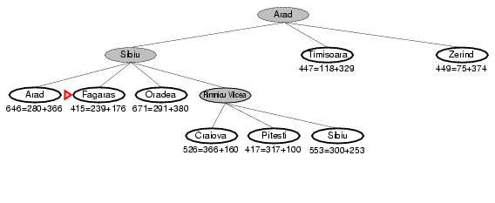
A* search example

Slide 99
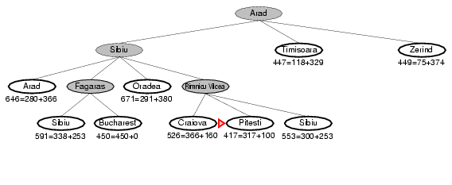
A* search example

Slide 100
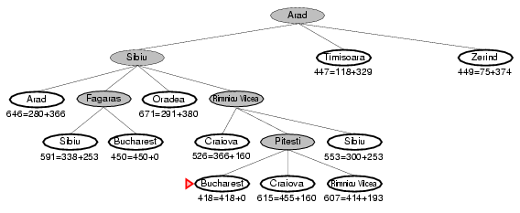
A* search example

Slide 101
Cont..
The path from Arad to Bucharest is
Arad-Siblu-Rimmio-Pitessi-Bucharest.
Though path thru fagaras is available to reach bucharest, it is costlier compare to the above path.

Slide 102
Advantages of A* Algorithm
•It guarantees finding the optimal path when used with appropriate heuristics.
•It is efficient and can handle large search spaces by effectively pruning unpromising paths.
•It can be easily tailored to accommodate different problem domains and heuristics.
•A* is flexible and adaptable to varying terrain costs or constraints.

Slide 103
Disadvantages of A* Algorithm
•A* can be computationally expensive in certain scenarios, especially when the search space is extensive and the number of possible paths is large.
•The algorithm may consume significant memory and processing resources.
•Another limitation is that A* heavily relies on the quality of the heuristic function. If the heuristic is poorly designed or does not accurately estimate the distance to the goal, the algorithm's performance and optimality may be compromised.

Slide 104
A* SEARCH
Admissible Heuristics
h(n) is admissible if it never overestimates to reach its goal
h(n)<=h*(n) (true cost)
h(n)>0 for any goal state
hSLD never overestimates the actual distance
Hence A* using tree search is optimal
Consistency
h(n) is consistent if h(n)< c(n,a,n1)+h(n1)
f(n1) = g(n1)+h(n1)= g(n1)+c(n,a,n1)+h(n1) >=g(n)+h(n)=f(n)
f(n)=g(n)+h(n); f(n) always increases
Hence consistent

Slide 105
A* SEARCH
Completeness
Yes
Time complexity
Exponential with path length
Space Complexity
All nodes stored
Optimality
Yes

Slide 106
LOCAL SEARCH
Characteristics
Only reaching the goal state is important
Path cost is immaterial
Considers only the current node
Move to neighbours
Path followed is not stored
Hence requires less memory and finds reasonable solution in large search spaces
Useful for optimization problems
Objective function

Slide 107
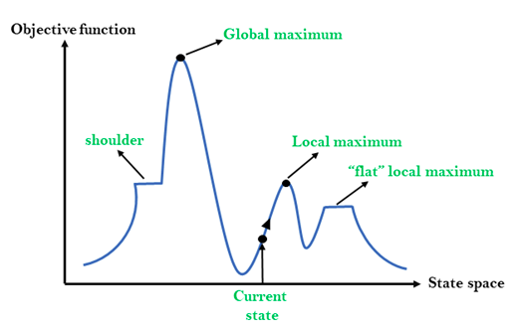
LOCAL SEARCH
Consider a State-space landscape with location and elevation

Slide 108
HILL CLIMBING
Characteristics
Heuristic for optimizing problems mathematically
Choose values from the input to maximize or minimize a real function
Uses greedy approach

Slide 109
TYPES OF HILL CLIMBING
Simple Hill Climbing
-Single node selection
Steepest Ascent
-Examines all the neighboring nodes of the current state and selects one neighbor node which is closest to the goal state.
Stochastic
Random node selection

Slide 110
Simple Hill climbing
Evaluate the initial state. If it is a goal state then stop and return success. Otherwise, make the initial state as the current state.
Loop until the solution state is found or there are no new operators present which can be applied to the current state.
Select a state that has not been yet applied to the current state and apply it to produce a new state.
Perform these to evaluate the new state.
If the current state is a goal state, then stop and return success.
If it is better than the current state, then make it the current state and proceed further.
If it is not better than the current state, then continue in the loop until a solution is found.
Exit from the function.

Slide 111
Steepest Ascent Hill climbing
Evaluate the initial state. If it is a goal state then stop and return success. Otherwise, make the initial state as the current state.
Repeat these steps until a solution is found or the current state does not change
Select a state that has not been yet applied to the current state.
Initialize a new ‘best state’ equal to the current state and apply it to produce a new state.
Perform these to evaluate the new state
If the current state is a goal state, then stop and return success.
If it is better than the best state, then make it the best state else continue the loop with another new state.
Make the best state as the current state and go to Step 2 of the second point.
Exit from the function.

Slide 112
Stochastic hill climbing
Evaluate the initial state. If it is a goal state then stop and return success. Otherwise, make the initial state the current state.
Repeat these steps until a solution is found or the current state does not change.
Select a state that has not been yet applied to the current state.
Apply the successor function to the current state and generate all the neighbor states.
Among the generated neighbor states which are better than the current state choose a state randomly (or based on some probability function).
If the chosen state is the goal state, then return success, else make it the current state and repeat step 2 of the second point.
Exit from the function.

Slide 113
ISSUES IN HILL CLIMBING
Local Maximum
Neighbouring states values < Current state value
Backtracking to overcome it
Plateau
Neighbouring states have same value
Random branching
Make a big jump to try to get in a new section.
Ridge
-The orientation of the high region, compared to the set of available moves, makes it impossible to climb up.
However, two moves executed serially may increase the height. -Downward movement
Move in possible directions to overcome it

Slide 114
SIMULATED ANNEALING
Simulated Annealing
A alternative to a random-restart hill-climbing when stuck on a local maximum is to do a ‘reverse walk’ to escape the local maximum.
A derivative of the process of heating and then slowly cooling a substance to obtain a strong crystalline structure.
Temperature reduced slowly in stages till the system ``freezes" and no further changes occur

Slide 115
TWO PLAYER GAMES
Multi Agents
Creating game-playing programs in AI
Many similarities to search & most of the games
have two players,
are zero-sum: what one player wins, the other loses
have perfect information: the entire state of the game is known to both players at all times
E.g., tic-tac-toe, checkers, chess, Go, backgammon, …
games without perfect information;
Need probability theory, game theory
e.g., poker
Known as Adversarial Search

Slide 116
TWO PLAYER GAMES
SUM TO 2 GAME
Player 1 moves, then player 2, finally player 1 again
Move = 0 or 1
Player 1 wins if and only if all moves together sum to 2

Slide 117
TWO PLAYER GAMES
MINIMAX ALGORITHM
2 Players MAX and MIN
MAX moves first and take turns with MIN till end of the game
Points awarded to winner and penalty to loser
Search Problem with agents having:
Initial State(S0)
Player(S): Player P’s turn for move in state S
Action(S): Returns the set of possible moves in state S
Result(S,A): Result of the move
TerminalTest(S): If end of game then true else false
Utility(S,P): Final numeric value for a game that ends in terminal state, S for player-P;
Zero Sum is total payoff

Slide 118
TWO PLAYER GAMES
MINIMAX ALGORITHM

Slide 119
TWO PLAYER GAMES
TWO PLY GAME TREE

Slide 120
TWO PLAYER GAMES
TWO PLY GAME TREE (Recursive)
Possible moves for MAX at root node (a1,a2,a3)
Possible replies by MIN for a1 is (b1,b2,b3)
One move each by MAX and MIN to reach end of game
Ply: Each move by a player at depth level, d
Optimal strategy identified from MINIMAX value of each node

Slide 121
TWO PLAYER GAMES
TWO PLY GAME TREE
Time Complexity: O(b^{m})
Space Complexity: O(bm) or O(m)

Slide 122
Minimax
1944 - John von Neumann outlined a search method (Minimax) that maximise your position whilst minimising your opponent’s
Minimax searches state space using the following assumptions
your opponent is ‘as clever’ as you
if your opponent can make things worse for you, they will take that move
your opponent won’t make mistake

Slide 123
Minimax Procedure
Start a MAX (MIN) node with current board configuration
Expand nodes down to some depth of lookahead in the game
Apply the evaluation function at each of the leaf nodes
“Back up” values for each of the non-leaf nodes until a value is computed for the root node
at MIN nodes, the backed-up value is the minimum of the values associated with its children
at MAX nodes, the backed-up value is the maximum of the values associated with its children
Pick the operator associated with the child node whose backed-up value determined the value at the root

Slide 124
Minimax - Example
MAX
1
A
MIN
1
B
-3
C
MAX
4
D
1
E
2
F
-3
G
4
-5
-5
1
-7
2
-3
-8
= terminal position
= agent
= opponent

Slide 125
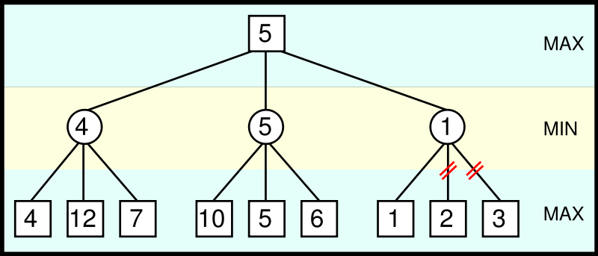
TWO PLAYER GAMES
ALPHA BETA PRUNING
Prunes away branches that cannot possibly influence final minimax decision
Returns same move as general minimax
Eg: From Max point of view, 1 is already lower than 4 or 5, so no need to evaluate 2 and 3 (bottom right) → Prune

Slide 126
Alpha-Beta Pruning
We can improve on the performance of the minimax algorithm through alpha-beta pruning.
Basic idea: “If you have an idea that is surely bad, don't take the time to see how truly awful it is.” -- Pat Winston
We don’t need to compute the value at this node.
No matter what it is it can’t affect the value of the root node
>=2
MAX
=2
<=1
MIN
MAX
2
7
1
?

Slide 127
Alpha-Beta Pruning
Traverse the search tree in depth-first order
At each MAX node n, alpha(n) = maximum value found so far
At each MIN node n, beta(n) = minimum value found so far
Note: The alpha values start at -infinity and only increase, while beta values start at +infinity and only decrease.
Beta cutoff: Given a MAX node n, cut off the search below n (i.e., don’t generate or examine any more of n’s children) if alpha(n) >= beta(i) for some MIN node ancestor i of n.
Alpha cutoff: stop searching below MIN node n if beta(n) <= alpha(i) for some MAX node ancestor i of n.

Slide 128
MAX
A
MIN
B
C
<=6
MAX
D
E
6
>=8
H
I
J
K
6
5
8
= agent
= opponent

Slide 129
MAX
>=6
A
MIN
B
C
6
<=2
MAX
D
E
F
G
6
>=8
2
H
I
J
K
L
M
6
5
8
2
1
= agent
= opponent

Slide 130
MAX
>=6
A
MIN
B
C
6
2
MAX
D
E
F
G
6
>=8
2
H
I
J
K
L
M
6
5
8
2
1
= agent
= opponent

Slide 131
Alpha-beta Pruning
MAX
6
A
MIN
B
C
6
2
alpha cutoff
MAX
D
E
F
G
6
>=8
beta cutoff
2
H
I
J
K
L
M
6
5
8
2
1
= agent
= opponent

Slide 132
Condition for Alpha-beta pruning
The main condition which required for alpha-beta pruning is:
α>=β
Key points about alpha-beta pruning:
The Max player will only update the value of alpha.
The Min player will only update the value of beta.
While backtracking the tree, the node values will be passed to upper nodes instead of values of alpha
and beta.
We will only pass the alpha, beta values to the child nodes.

Slide 133
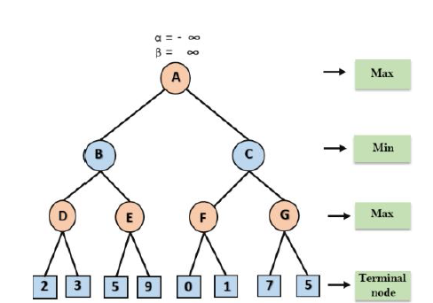
At the first step the, Max player will start first move from node A where α= -∞ and β= +∞, these value of alpha and beta passed down to node B where again α= -∞ and β= +∞, and Node B passes
the same value to its child D.

Slide 134
Step 2: At Node D, the value of α will be calculated as its turn for Max. The value of α is compared with firstly 2 and then 3, and the max (2, 3) = 3 will be the value of α at node D and node value will also 3.
Step 3: Now algorithm backtrack to node B, where the value of β will change as this is a turn of Min, Now β= +∞, will compare with the available subsequent nodes value, i.e. min (∞, 3) = 3, hence at node B now α= -∞, and β= 3.
In the next step, algorithm traverse the next successor of Node B which is node E, and the values of α= -∞, and β= 3 will also be passed.

Slide 135
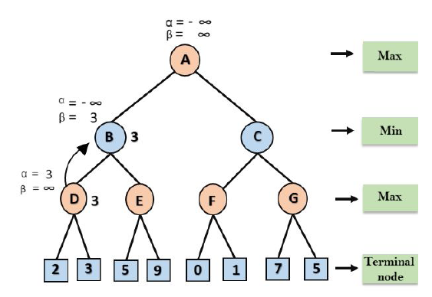

Slide 136
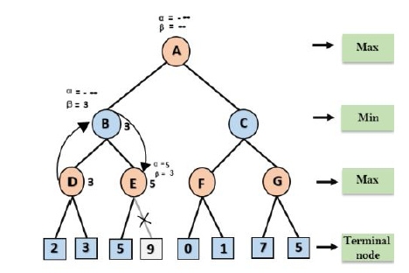
Step 4: At node E, Max will take its turn, and the value of alpha will change. The current value of alpha will be compared with 5, so max (-∞, 5) = 5, hence at node E α= 5 and β= 3, where α>=β, so the right successor of E will be pruned, and algorithm will not traverse it, and the value at node E will be 5.

Slide 137
Step 5: At next step, algorithm again backtrack the tree, from node B to node A. At node A, the value of
alpha will be changed the maximum available value is 3 as max (-∞, 3)= 3, and β= +∞, these two values now passes to right successor of A which is Node C.
At node C, α=3 and β= +∞, and the same values will be passed on to node F.
Step 6: At node F, again the value of α will be compared with left child which is 0, and max(3,0)= 3, and then compared with right child which is 1, and max(3,1)= 3 still α remains 3, but the node value of F will become 1.

Slide 138
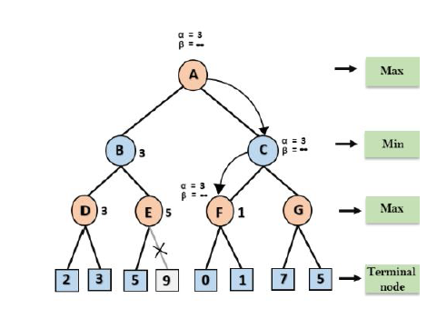

Slide 139
Step 7: Node F returns the node value 1 to node C, at C α= 3 and β= +∞, here the value of beta will be changed, it will compare with 1 so min (∞, 1) = 1. Now at C, α=3 and β= 1, and again it satisfies the condition α>=β, so the next child of C which is G will be pruned, and the algorithm will not compute the entire sub-tree G.
Step 8: C now returns the value of 1 to A here the best value for A is max (3, 1) = 3. Following is the final game tree which is the showing the nodes which are computed and nodes which has never computed.
Hence the optimal value for the maximizer is 3 for this example.

Slide 140
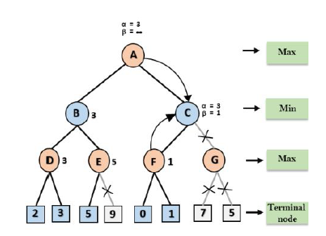

Slide 141
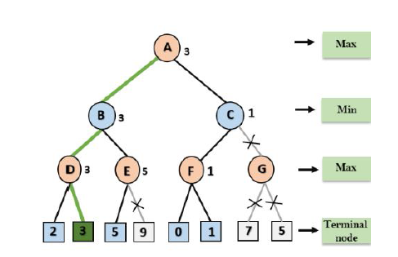
Graph after pruning

Slide 142
Both minimax and alpha-beta pruning assume perfect play from the opposition
Increase in processing power will not always make exhaustive search of game tree possible – need pruning techniques to increase the search depth with the same computing resources

Slide 143
Advantages of Alpha-Beta Pruning
Efficiency: Alpha-beta pruning significantly reduces the number of nodes evaluated compared to the basic minimax algorithm, making the search process faster.
Optimality: Despite pruning, alpha-beta pruning does not affect the final decision; it still guarantees finding the optimal move.
Limitations of Alpha-Beta Pruning
Complexity: While it reduces the number of evaluations, the complexity can still be high for very large game trees.
Heuristic Dependency: The effectiveness of alpha-beta pruning can be highly dependent on the order in which nodes are evaluated. Good heuristic functions or move ordering can greatly enhance its performance.

